Slide 1
Psychotropic medications
(CNS pharmacology)
Dr Ken Wojcikowski

Slide 2
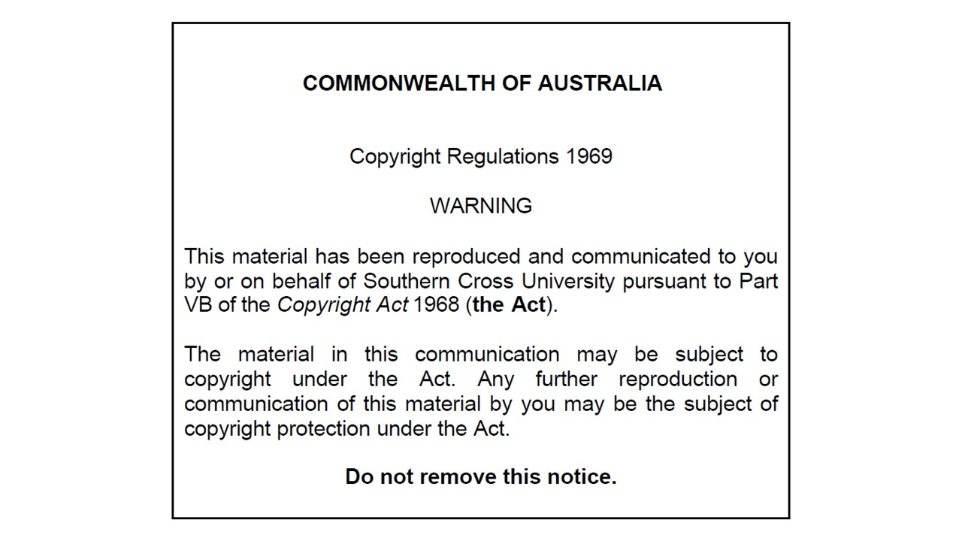

Slide 3
Overall objectives for psychotropic medications
For each of the disorders listed below, briefly explain the clinical manifestations of the disorder, the hypothesised neurologic abnormalities, and the mechanisms by which the commonly prescribed medications help correct the neurologic abnormality.
  Parkinson’s disease
  Alzheimer’s disease
  Anxiety disorders,
  Depression,
  Schizophrenia and other psychotic disorders and
  Seizure syndromes
And for each of the medications discussed, note any associated suffix, and explain the side effects and contraindications

Slide 4
Medications that treat
Neurodegenerative disorders:
Parkinson’s disease

Slide 5
Objectives for Part 1: Neurodegenerative Medicines
Describe Parkinson’s and Alzheimer’s disease with respect to the neurologic changes that occur.
Briefly explain the mechanism by which the following drugs exert their therapeutic effects, and the major indications, contraindications and side effects.
  Parkinson’s: carbidopa/levodopa (Sinemet); *Benzatropine (Benztropine)*
  Alzheimer’s: *donepezil*; *memantine*

Slide 6
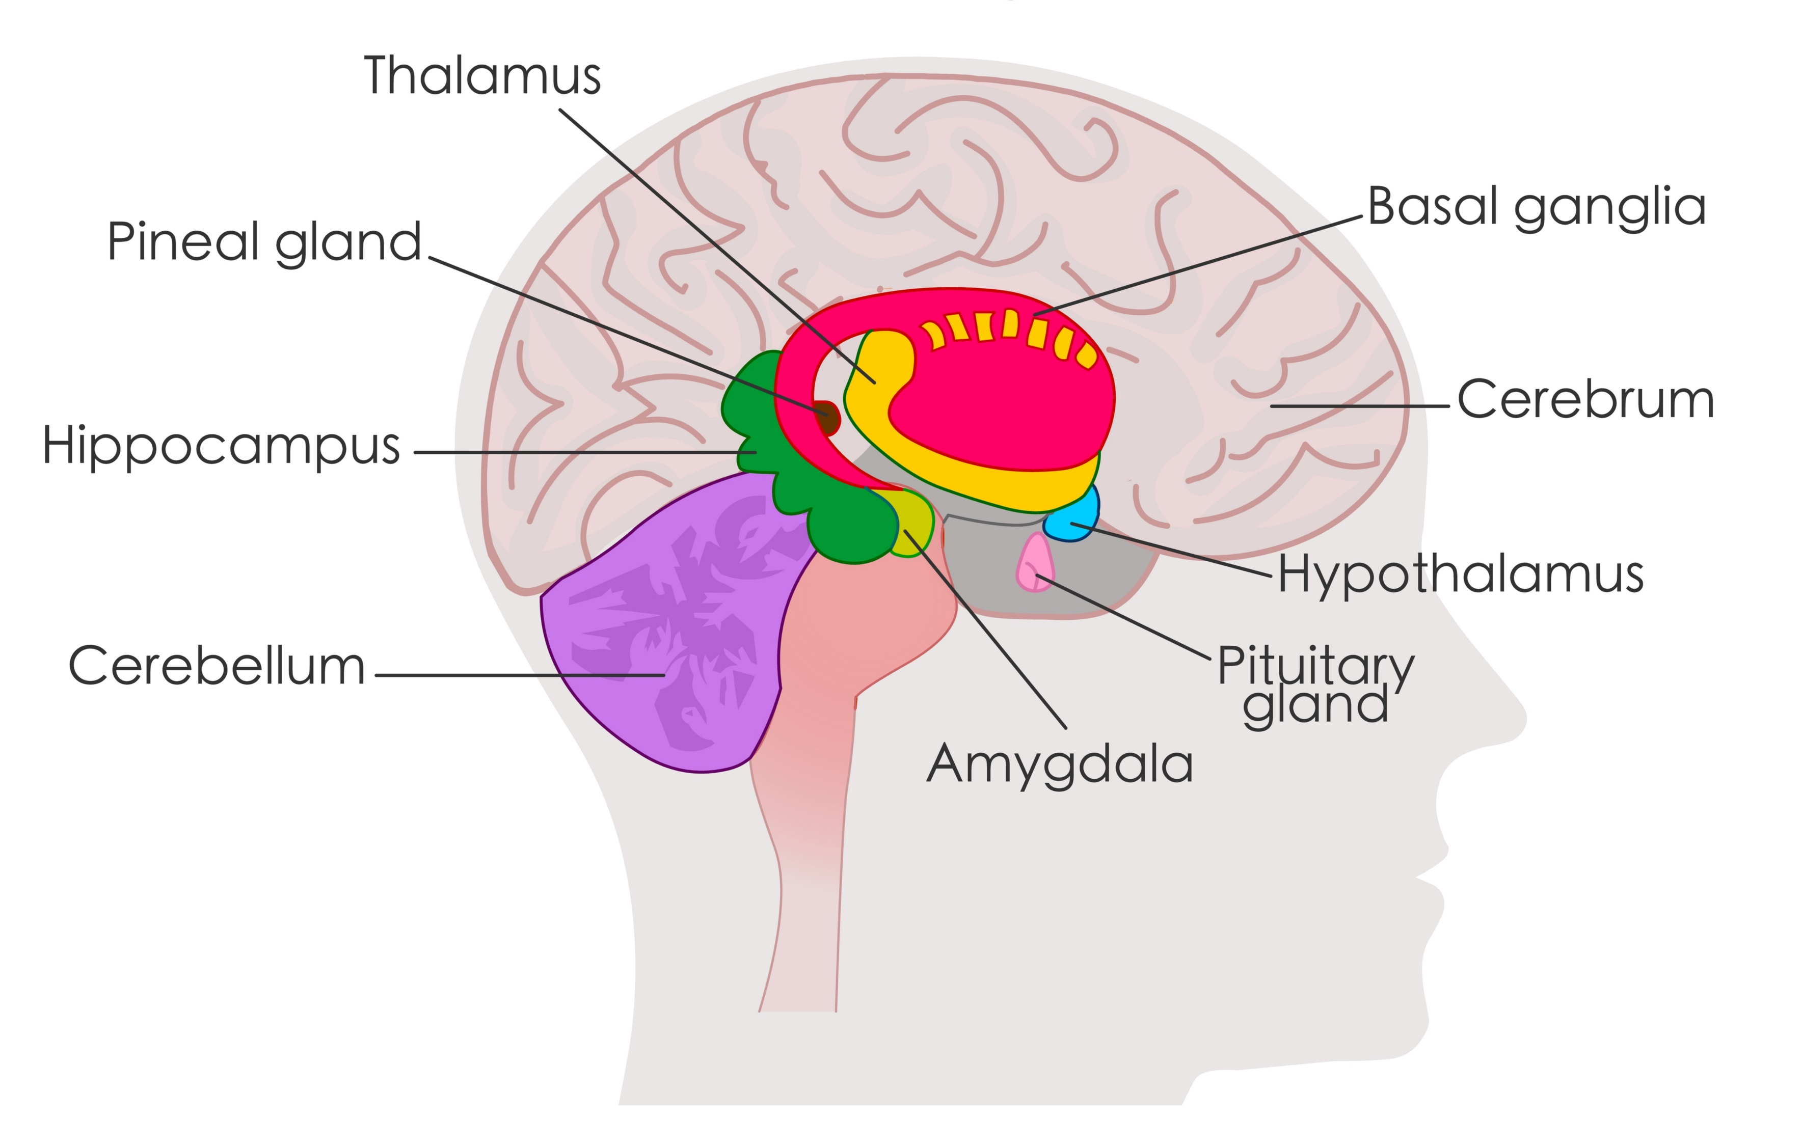
Parkinson’s disease results in a decrease in dopamine-neurons in the basal ganglia

Slide 7
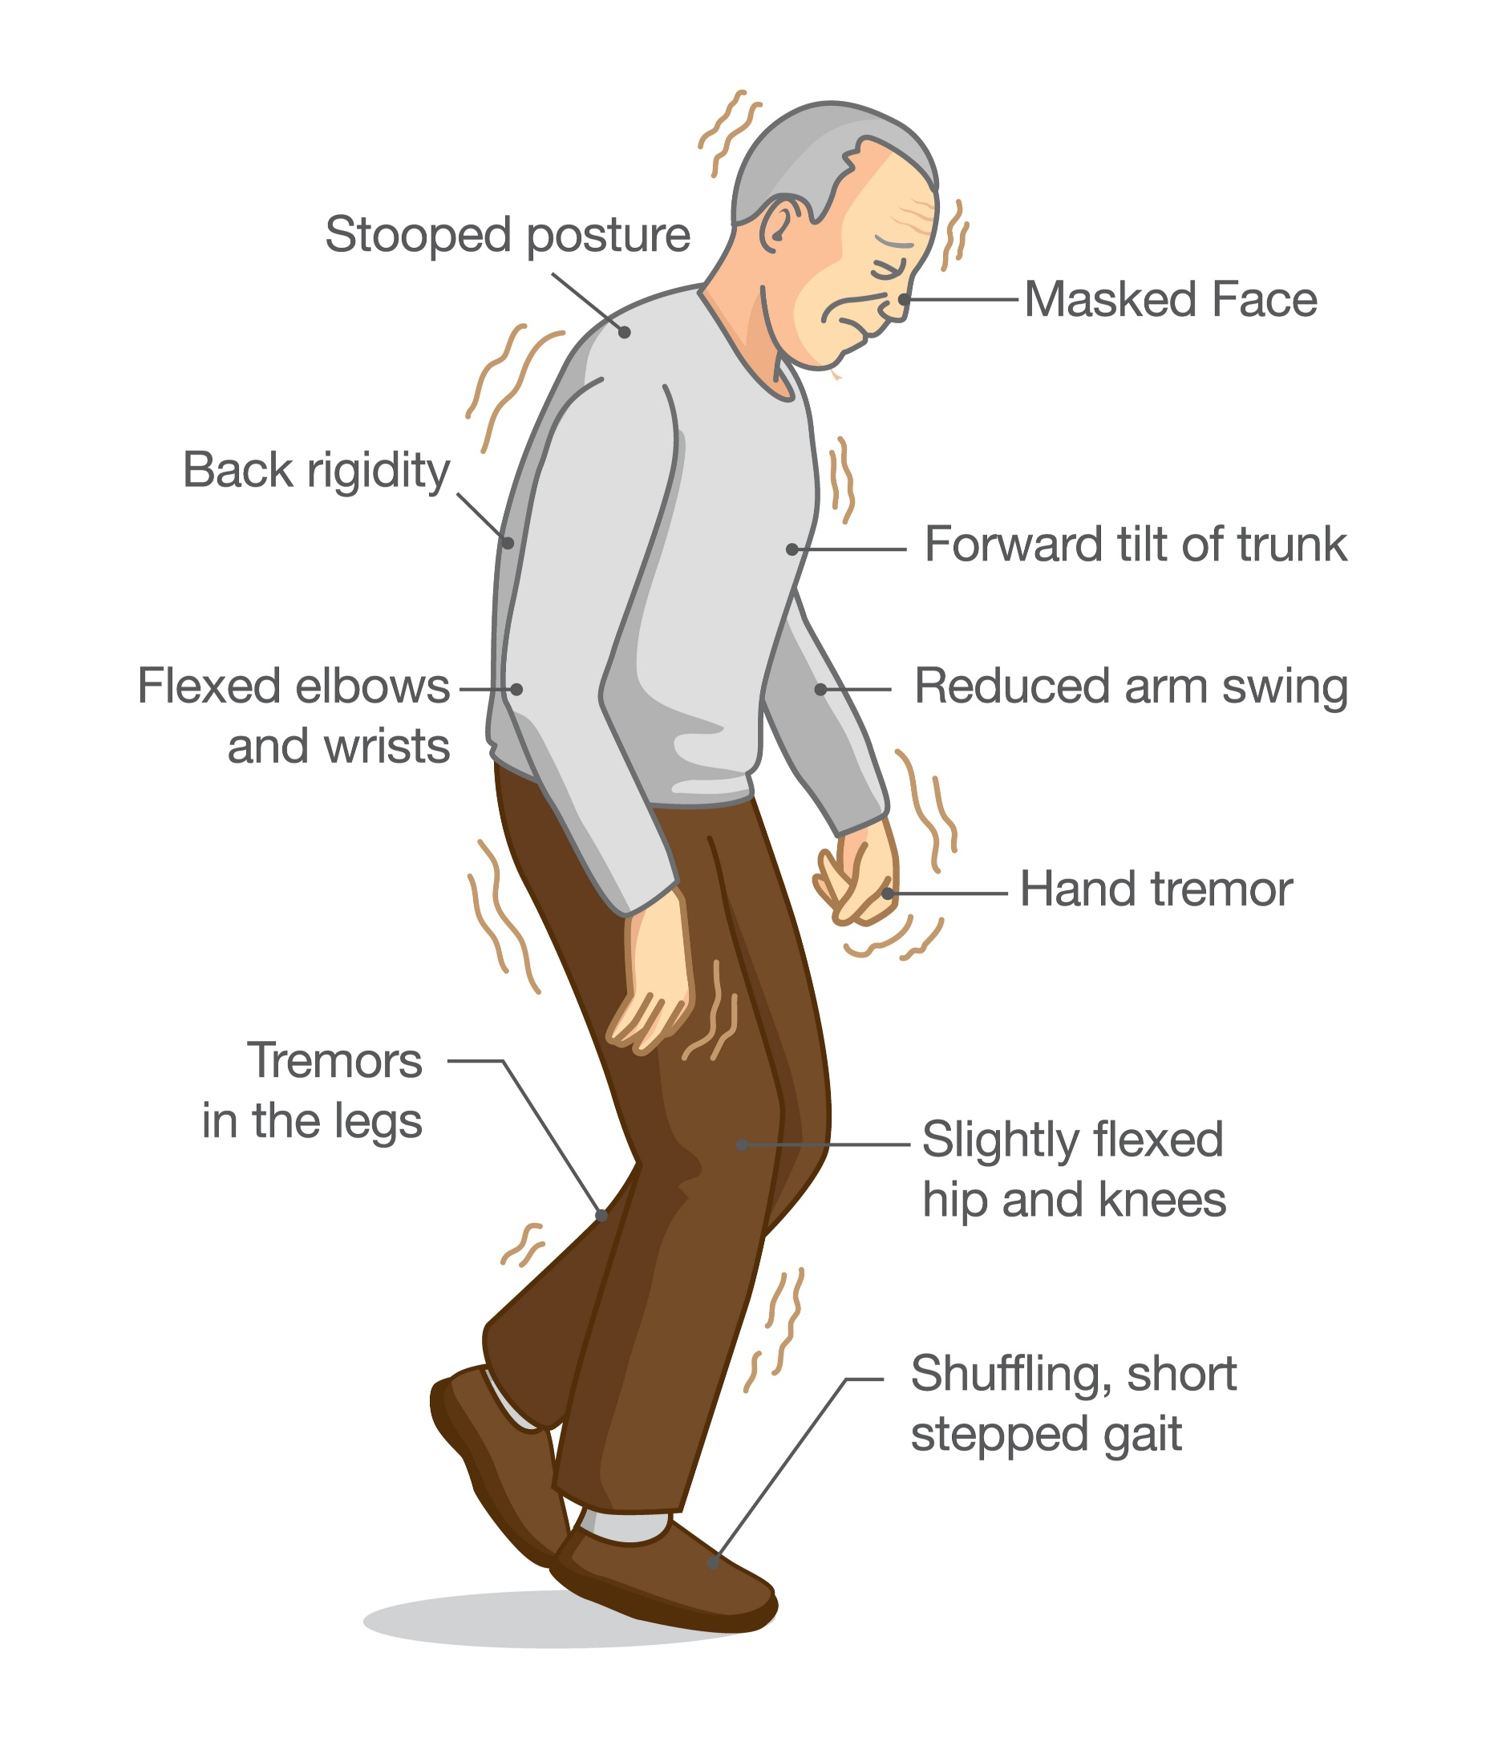
Parkinson’s disease
Affects part of the extrapyramidal system
The part of brain involved is basal ganglia
  Controls involuntary movements
  Initiation of muscular movement
  Fine muscle movement
  Muscle tone
Characterised by pill-rolling tremor, hypokinesia, shuffling gate, muscle rigidity.

Slide 8
Parkinson’s disease
Affects part of the _______________ system
The part of brain involved is _________, which has these actions:
  ____
  ____
  ____
  ____
Characterised by:

Slide 9

Parkinson’s disease
We start with this:
Acetylcholine Dopamine
Balance between cholinergic and dopaminergic nerve activity is upset by too little dopamine
  Too much cholinergic activity relative to dopamine
Two solutions:
  Increase dopamine
    Carbidopa/Levodopa
  Decrease cholinergic activity
    Antimuscarinics
      *Benztropine*
Parkinson’s results in this:
Acetylcholine Dopamine
We compromise with this:
Acetylcholine Dopamine

Slide 10
Antimuscarinic / anticholinergic medications
These drugs restore the balance between acetylcholine and dopamine (the ultimate result is that both are decreased)
Only useful in the initial stages and when the dopaminergic drugs begin to be ineffective
Recall the side effects of drugs that decrease the parasympathetic (rest and digest) system
  Dry mouth, blurred vision, difficulty in micturition,
  Confusion and
  Hallucinations
Example: *Benzatropine* (benztropine in US texts)

Slide 11
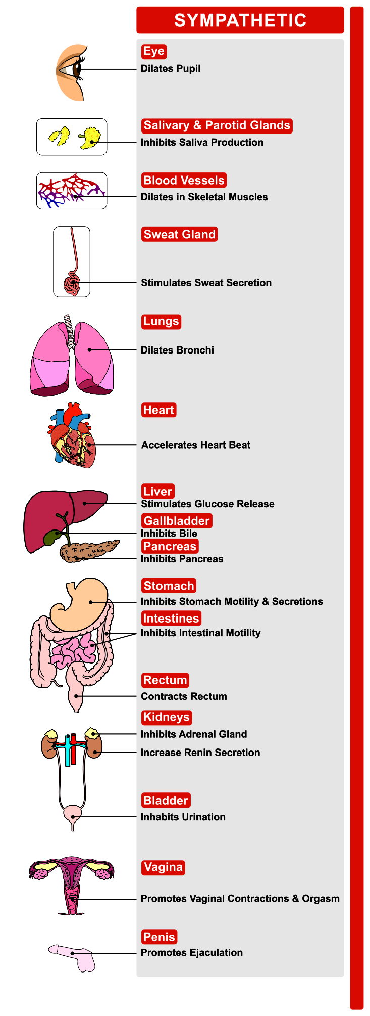
Recall that the anticholinergic drugs will make the sympathetic nervous system dominate:
Dry mouth, constipation, blurred vision, difficulty in micturition, tachycardia
*Benzatropine*

Slide 12
Increasing dopamine
Dopamine cannot cross the blood–brain barrier.
Levodopa, or L-dopa (precursor to dopamine) can cross the BBB
  Converted into dopamine in brain
BUT too much levodopa causes peripheral side effects
The enzyme that converts levodopa to dopamine is a DOPA decarboxylase.
Carbidopa inhibits this enzyme

Slide 13
Carbidopa and Levodopa (Sinemet)
Many common adverse effects
  Nausea, depression, agitation and confusion (although these are sometimes due to the disease itself), increased sexual activity, hypotension, delusions, dysrhythmias, as well as involuntary movements of the extremities, head, lips and tongue (dyskinesias).
On-off phenomenon
  Characterised by the affected person enjoying near-normal movement until severe disease symptoms suddenly develop.

Slide 14
Newer medications
All of the following aim to increase dopamine
(no need to learn)
Selegiline, rasagiline and entacapone inhibit the breakdown of the enzymes that break down dopamine
Amantadine inhibits the reuptake of dopamine from the synaptic cleft back into the first neuron
Bromocriptine, pramipexole and ropinirole are dopamine agonists that can cross into the brain
None of the medications reverse the changes that occur in this chronic progressive disorder

Slide 15
Medications that treat
Neurodegenerative disorders:
Alzheimer’s disease

Slide 16
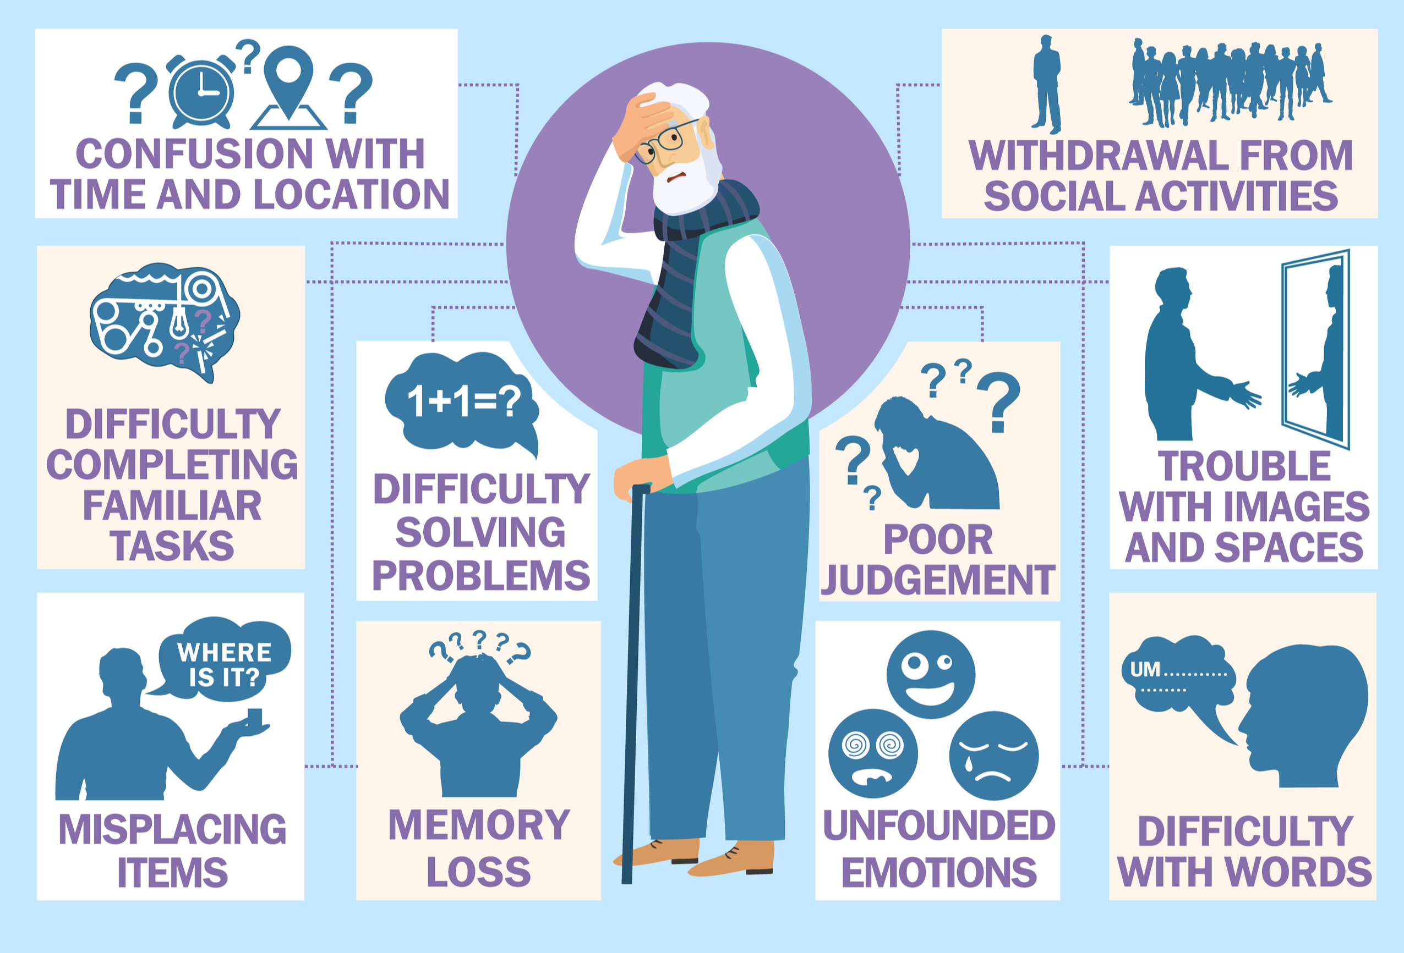

Slide 17
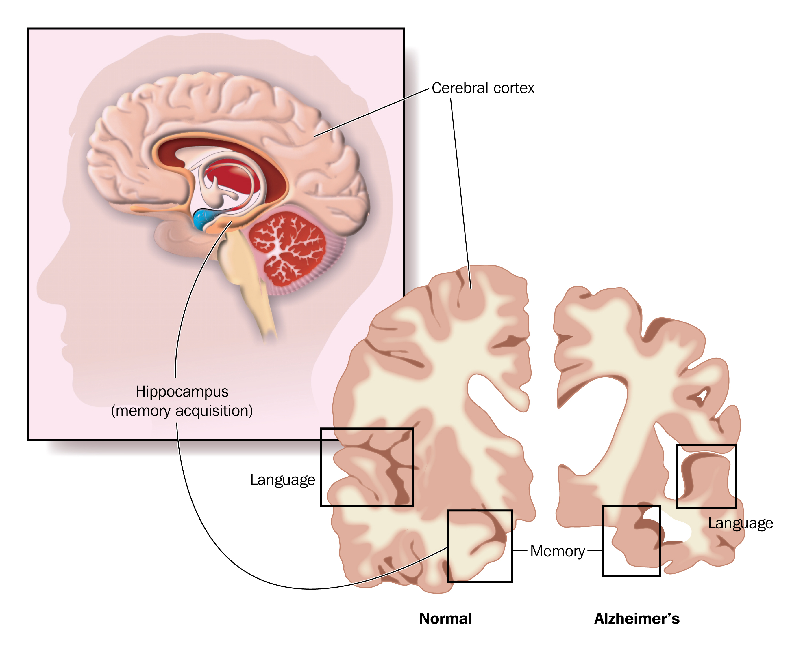
Alzheimer’s disease
Alzheimer’s disease is a form of dementia characterised by profound brain shrinkage
  Progressive deterioration of intellectual and cognitive functioning.
Two observations that have led to the current therapy
  Acetylcholine is reduced early in the course of the disease
  Glutamate levels have been found to be raised
The acetylcholinesterase inhibitors are used to enhance cholinergic transmission, while the use of the glutamate receptor antagonist memantine reduces the excitotoxic effects of glutamate.

Slide 19
Acetylcholinesterase inhibitors (*donepezil*)
By blocking the enzyme that degrades acetylcholine, more neurotransmitter will be available and its action prolonged.
Common adverse effects
  Donepezil produces a number of common adverse effects, which include nausea, vomiting, elevated liver enzyme levels, diarrhoea, dizziness, anorexia, myalgia and dyspepsia
  These drugs may reduce deterioration in cognition but do not stop the pathological process or yield a cure

Slide 20
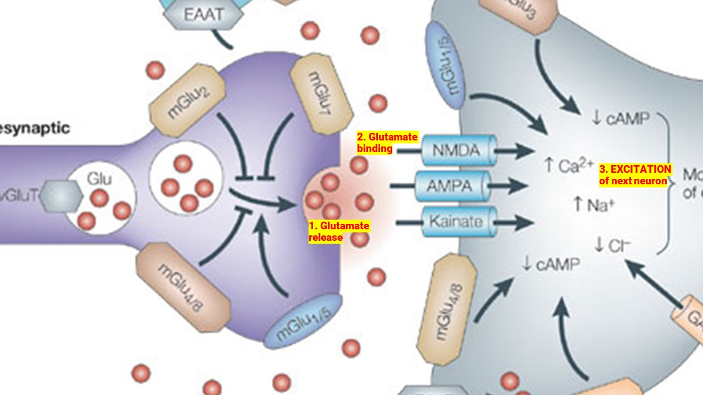
Glutamate
Glutamate is the most abundant excitatory neurotransmitter in the nervous system
Glutamate binding results in increased Na⁺, Ca²⁺ or decreased Cl⁻ , depending on the receptor to which it binds. (In each case, that leads to excitation.)
For instance, glutamate binds to the NMDA receptor, allowing more calcium to flow in (more excitation)

Slide 21
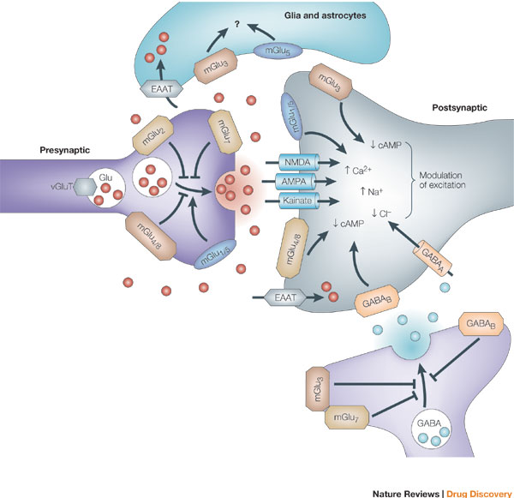
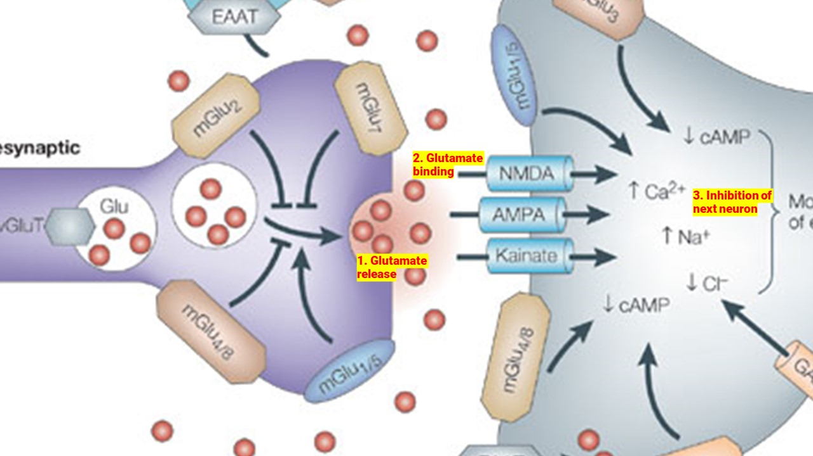
2. Glutamate binding
3. EXCITATION of next neuron
1. Glutamate release

Slide 22
Memantine blocks glutamate at the NMDA receptor
The brain is very vulnerable to glutamate-mediated overexcitation; this results in excitotoxicity.
Ultimately, with this overexcitation, cell integrity is disrupted and the nerve cell dies.
Part of the process of Alzheimer's disease may have to do with this excitotoxicity from excess glutamate.
The psychotropic agent memantine is a selective NMDA receptor antagonist.
  This decreases calcium influx and decreases excitation

Slide 23
Glutamate receptor antagonists
Memantine is indicated in the management of moderate to severe Alzheimer’s disease.
Mechanism of action
  Memantine is an NMDA receptor antagonist that selectively restores the ungated receptors to the gated state and inhibits prolonged calcium ion influx without affecting normal glutamate neurotransmission.
Common adverse effects
  Agitation, insomnia, drowsiness, dizziness, headache, gastrointestinal disturbances and coughing.

Slide 24
Psychotropic medications (part 2):
Anxiolytics and hypnotics
Dr Ken Wojcikowski

Slide 25
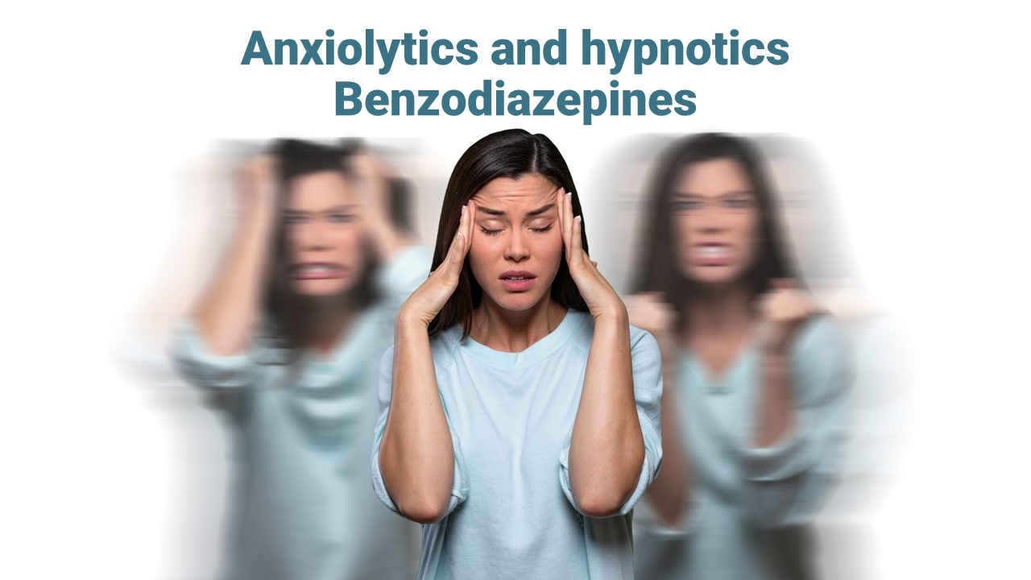
Anxiolytics and hypnotics:
Benzodiazepines

Slide 26
Anxiolytics and hypnotics
Anxiolytics, minor tranquiliser and sedative are often used interchangeably and are described as a substance that diminishes the activity of the CNS. Sedatives calm a person receiving therapy, and moderate excitability.
‘Hypnotic’ is the term used to describe a substance that induces sleep
  Often difficult to distinguish
Many of the medicines in these categories can induce psychological dependence

Slide 27
Objectives for Part 2
Anxiolytics and Hypnotics
For each of the anxiolytics listed below, give an example of the drug class, the general mechanism by which it exerts its therapeutic effects, the indications, contraindications and most important side effects.
Benzodiazepines (*Diazepam* , *Alprazolam*, *Clonazepam* and *Lorazepam* )
Azapirones (*Buspirone*)
Make sure you know the ZEPAM and ZOLAM SUFFIXES!

Slide 28
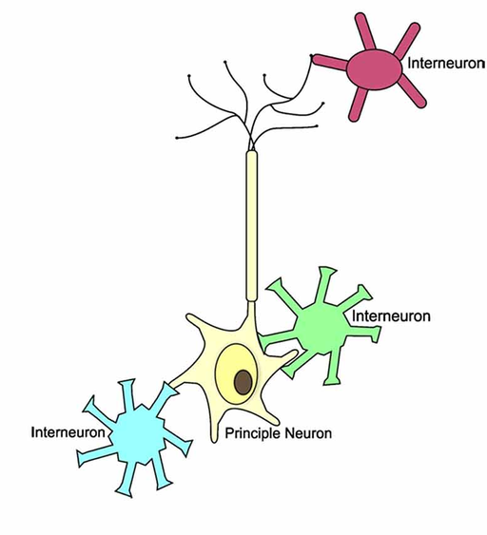
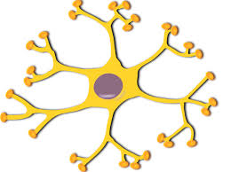
Interneurons vs neurons
Over 75% of the neurons in the brain are interneurons
Especially important in the portion of the brain responsible for anxiety
Principal neuron

Slide 29
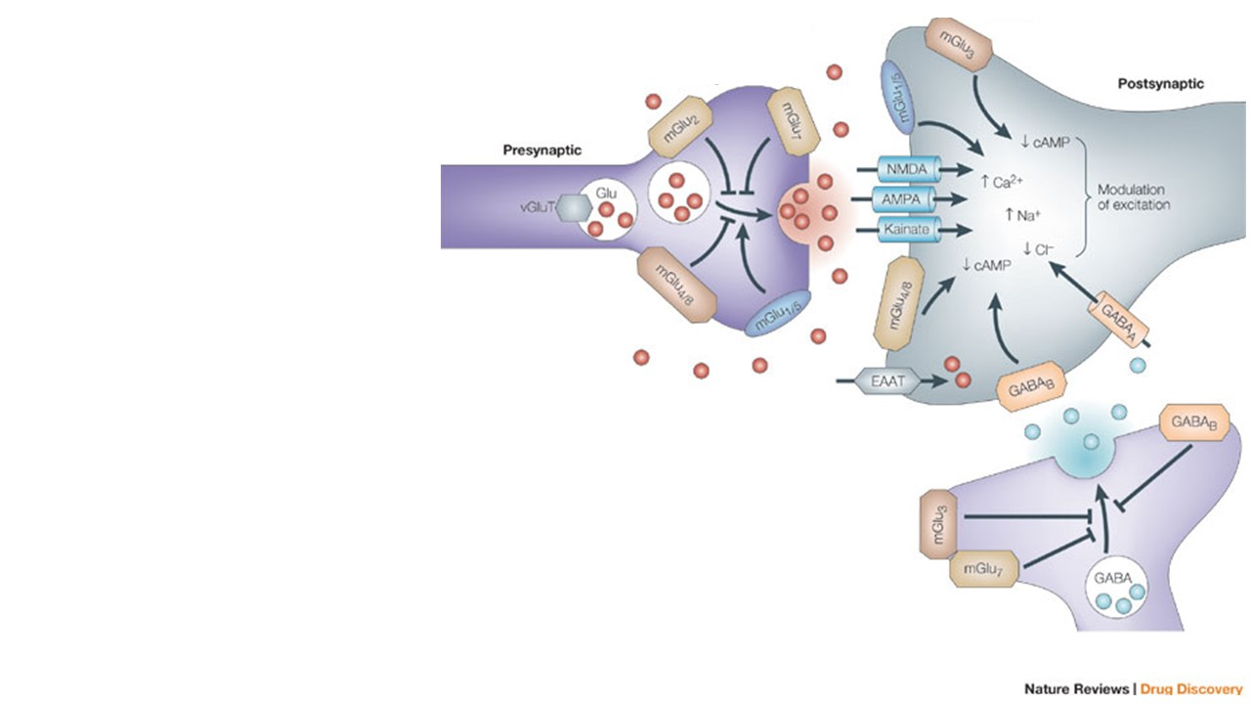
Presynaptic neuron
Postsynaptic neuron
Glutamate release
GABA release
Neurons in the brain
Inhibitory interneurons

Slide 30
Postsynaptic neuron with GABA receptors
Benzodiazepines
Benzodiazepines potentiate the actions of the inhibitory neurotransmitter GABA
Interneurons that release GABA

Slide 31
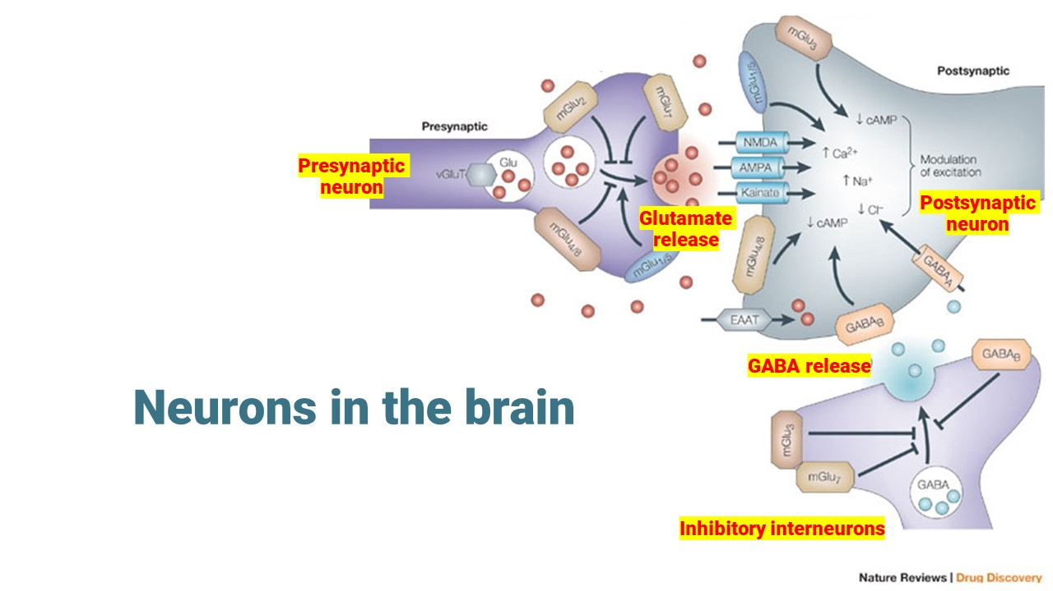
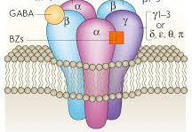
GABA
GABA is the main inhibitory neurotransmitter – interneurons use GABA
When GABA binds to receptor, chloride flows into the cell, making it more negative
  This decreases the firing of those neurons
Anxiety states are treated with drugs that potentiate the inhibitory actions of GABA or to open the GABA channels.
Chloride flows into cell
Chloride flow
on GABA binding
Opening chloride channels cancels the excitatory
effect of opening sodium channels

Slide 32
Benzodiazepines
Benzodiazepines are the most commonly prescribed anxiolytics/hypnotics.
Most of the benzodiazepines have the suffix –ZEPAM or ZOLAM
  (*Diazepam* , *Alprazolam*, *Clonazepam* and *Lorazepam*)
Mechanism of action
This group of medicines acts on gamma-aminobutyric acid (GABA) receptors in the CNS to potentiate its inhibitory action throughout the CNS

Slide 33
Diazepam, Alprazolam and other
…zepam and …zolam drugs
Diazepam first marketed as Valium
Commonly used to treat anxiety, panic attacks, muscle spasms,
Can be given parenterally
LONG half life (50-100 hours)
Alprazolam is unique among the benzodiazepines, as it possesses antidepressant activity
Addictive
Half-life of 11.2 hours
Caution in the elderly and those with hepatic disease
Flumazenil (romazicon) is used in overdose

Slide 34
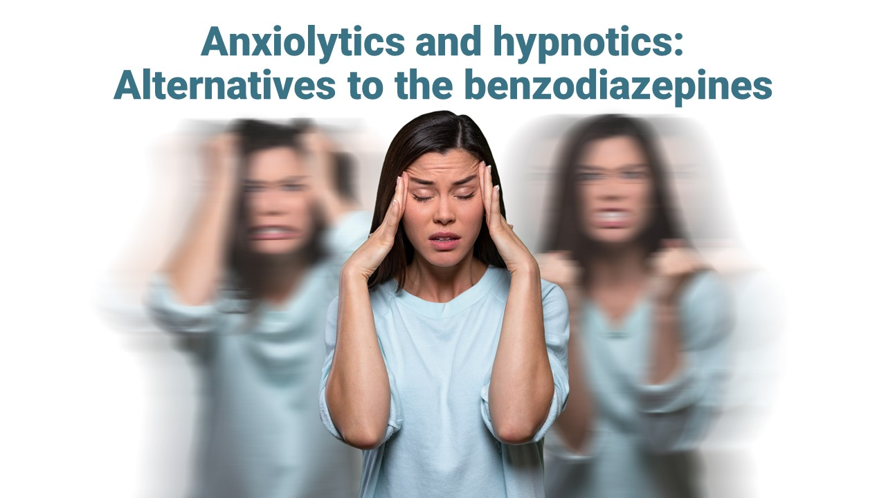
Anxiolytics and hypnotics:
Alternatives to benzodiazepines
Further information about benzodiazepines will be presented as we discuss the anti-seizure drugs

Slide 35
Anxiolytics and hypnotics:
Alternatives to benzodiazepines

Slide 36
  Azapirones (*Buspirone*)
Buspirone is an anxiolytic psychotropic drug
It is primarily used to treat generalized anxiety disorder (GAD).
It is not related to benzodiazepines or barbiturates
No addiction potential
Mechanism: serotonin receptor partial agonist
Common adverse effects (>10%) Dizziness, Headache, sleepiness

Slide 37
Other drugs with sedative and hypnotic effects
The FIRST GENERATION H1-antihistamines
Available as over-the-counter sedative/hypnotic medicines.
  *Hydroxyzine*
  Half life in adults 20 hours; half life in children 7 hours
  Drowsiness may remain the next day
  Tolerance to the anti-anxiety and hypnotic effects may develop over time.
  NOT suitable for elderly clients as the half-life increases to 30 hours and is associated with increased risk of developing Alzheimer’s disease.

Slide 38
Other drugs with sedative and hypnotic effects
α2-adrenoceptor agonists *Clonidine*
Off-label treatment of anxiety
Inhibits the release of norepinephrine (noradrenaline) in a form of negative feedback.
Also treats drug withdrawal (alcohol and opioids)
Many antidepressants have anxiolytic effects
(see following section)

Slide 39
Psychotropic medications: Part 3
Antidepressants
Dr Ken Wojcikowski

Slide 40
Antidepressants:
Definition and mechanisms of action

Slide 41
Objectives for Part 3:
CNS Antidepressants
Briefly state the definition and most common theory of depression.
Depression can be pharmaceutically treated using:
  Selective serotonin reuptake inhibitors (SSRI; *Sertraline*, *Escitalopram*, *Fluoxetine*).
  Serotonin noradrenaline reuptake inhibitors (SNRI’s; *Duloxetine*, *Venlafaxine*)
  Tricyclic antidepressants (TCAs; *Amitriptyline*),
  Also consider: Atypical (*Bupropion*, *Trazodone*)
For each of the drug classes listed above, state one or more specific drugs that fall under that class, the general postulated mechanism by which it exerts its therapeutic effects, and the major side effects.

Slide 42
Objectives for Part 3:
Antidepressants
Briefly state the definition and most common theory of depression.
Depression can be pharmaceutically treated using:
  Selective serotonin reuptake inhibitors (SSRI; *Sertraline*, *Escitalopram*, *Fluoxetine*).
  Serotonin noradrenaline reuptake inhibitors (SNRI’s; *Duloxetine*, *Venlafaxine*)
  Tricyclic antidepressants (TCAs; *Amitriptyline*),
  Also consider: Atypical (*Bupropion*, *Trazodone*)
For each of the drug classes listed above, state one or more specific drugs that fall under that class, the general postulated mechanism by which it exerts its therapeutic effects, and the major side effects.

Slide 43
Depression and bipolar disease
Depression is a state of profound sadness or melancholy. Common manifestations of this state include lethargy, apathy, loss of appetite, insomnia, feelings of unworthiness
  Biogenic amine hypothesis does not explain everything
In Bipolar disease, the patient experiences episodes of depression and mania, where the affected person cycles between the two extreme mood states.
Mania/manic - abnormally elevated arousal energy level

Slide 44
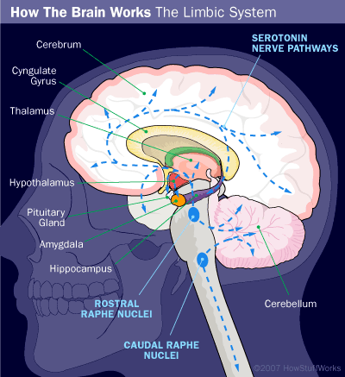
DEPRESSION:
Abnormalities are commonly found in the lateral prefrontal cortex that is involved in the regulation of emotion

Slide 45
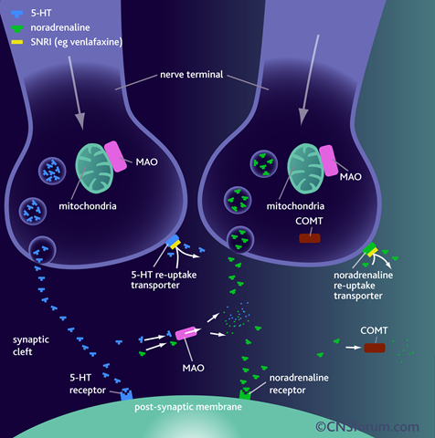
In the areas of the brain associated with mood, we use serotonin and noradrenaline (NA)

Slide 46
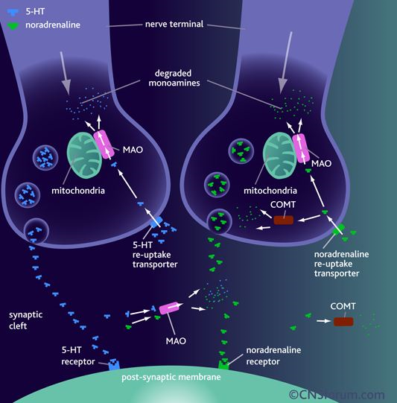

Slide 47
Monoamines are neurotransmitters that include:
Serotonin (5HT),
Dopamine,
Noradrenaline (NA or NE for norepinephrine) and
Adrenaline
Histamine
The deficit (or relative deficit) of serotonin or noradrenaline may be responsible for depression

Slide 48
Monoamine oxidase inhibitors
(MAOIs; phenelzine)
MAO is responsible for the degradation of the released noradrenaline.
In people taking MAOIs, the ingestion of food rich in tyramine has the potential to precipitate a widespread release of noradrenaline in the periphery that is unable to be broken down because MAO is inhibited.
Possible life-threatening cardiovascular stimulation.

Slide 49
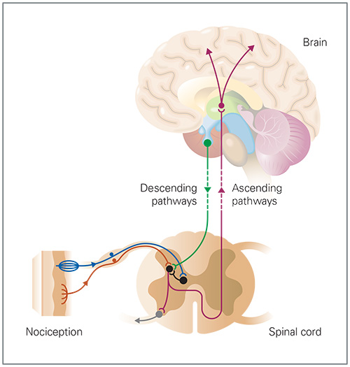
Why are some antidepressants good for pain?
A: there are serotonin and noradrenaline receptors in the “gate” that can block incoming stimuli

Slide 50
Antidepressants:
SSRIs and TCAs

Slide 51
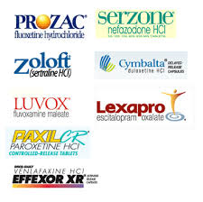
Selective serotonin reuptake inhibitors
(SSRIs)
*Sertraline* (Zoloft) is the most widely used, followed by *Escitalopram (Lexapro)* and *Fluoxetine (Prozac)*.
No common suffix but most antidepressants end with -pram, -mine, -tine, -line
They are considered the first-line agents in the treatment of major depression.
Take 4-6 weeks to be effective
May increase risk of suicide especially in people under 18y/o
The above depicts the most common SSRIs and SNRIs

Slide 52
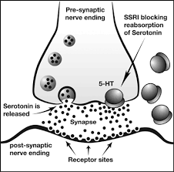

Slide 53
Selective serotonin reuptake inhibitors
(SSRIs)
*Sertraline* (Zoloft) is the most widely used, followed by *Escitalopram (Lexapro)* and *Fluoxetine (Prozac)*.
Many are indicated in major depression, panic disorder, social anxiety disorder, generalized anxiety disorder, and obsessive–compulsive disorder.
Sexual dysfunction and decreased libido are among the most commonly reported side effects.
Not to be withdrawn suddenly

Slide 54
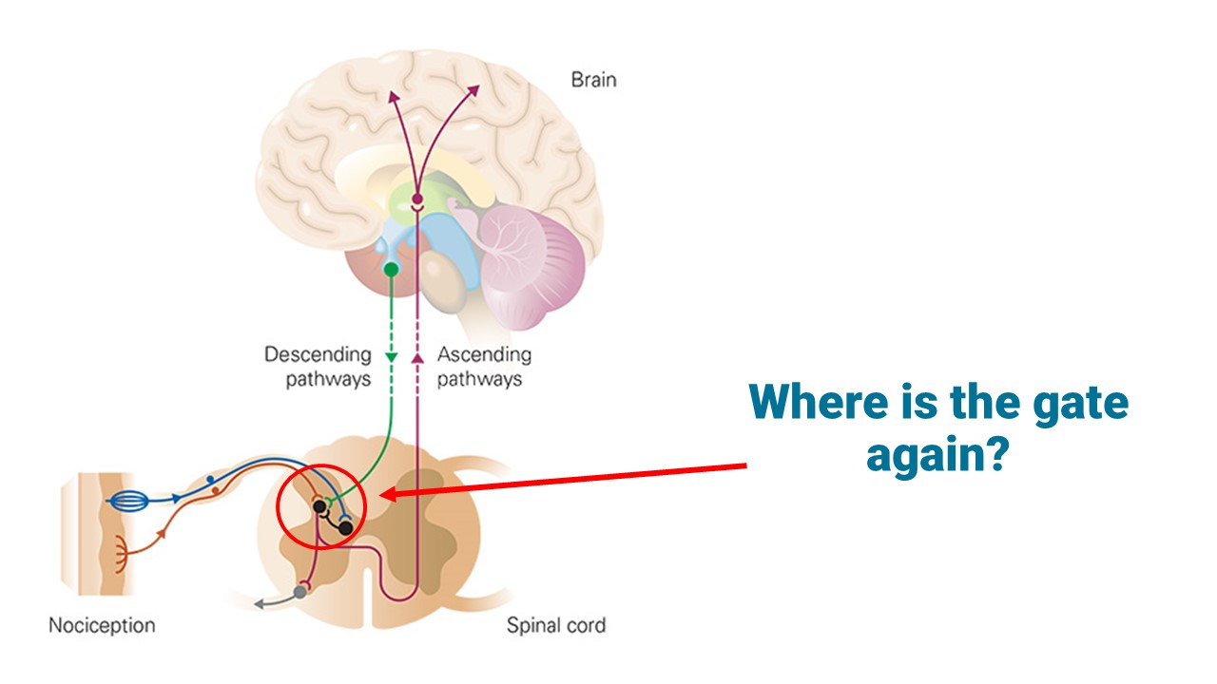
Tricyclic antidepressants (TCAs)
TCAs are still important in the management of depression but are not always the antidepressants of choice. *Amitriptyline*
Mechanism of action
  These drugs act primarily by blocking the amine reuptake pumps on the presynaptic terminal in the brain.
  The effect of decreasing pain occurs at ‘the gate’ of the spinal cord

Slide 55
Tricyclic antidepressants (TCAs)
Common adverse effects of TCAs
  Adverse effects derive from the fact that the TCAs have secondary actions:
  Antimuscarinic actions: dry mouth, blurred vision, constipation, urinary retention and tachycardia**.
  Central antihistamine actions: Mental confusion and sedation
  Antiadrenergic activity: postural hypotension
Contraindicated in patients with history of cardiovascular problems or epilepsy
(remember they block reuptake of noradrenaline)

Slide 56
SNRIs and Atypical Antidepressants

Slide 57
SNRIs
Serotonin and noradrenaline reuptake inhibitors (SNRIs)
Mechanism of action
Block the reuptake of noradrenaline, serotonin and, to some extent, dopamine from the synaptic gap. This action enhances neurotransmission
*Duloxetine* (Cymbalta) and *Venlafaxine* (Effexor)
The above depicts the most common SSRIs and SNRIs

Slide 58
SNRIs
Serotonin and noradrenaline reuptake inhibitors (SNRIs)
Mechanism of action
Block the reuptake of noradrenaline, serotonin and, to some extent, dopamine from the synaptic gap. This action enhances neurotransmission
The SNRIs produce less sedation, as well as fewer cardiovascular and antimuscarinic side-effects compared to the TCAs.
Always withdraw antidepressants slowly
All antidepressants may increase risk of suicide

Slide 59
Atypical antidepressants
*Bupropion* and *Trazodone* are atypical antidepressants.
Bupropion is a weak noradrenaline and dopamine inhibitor
Does not cause sexual dysfunction, weight gain or sleepiness
Can be used as an add-on to SSRIs
Is effective for reducing nicotine cravings
Trazodone blocks the reuptake of serotonin but it also blocks the postsynaptic serotonin receptors of subtype 2 A which are thought to contribute to depression.
Indicated for depression, alcohol withdrawals and anxiety disorders
Doesn’t have anticholinergic effects

Slide 60
Bipolar disorder (manic-depressive)
Alternates between mania (euphoria) and depression
Note that mania is the opposite to depression and is not another term for extreme or acute
Treatment:
  Lithium carbonate,
  The antiseizure agents (carbamazepine, sodium valproate, lamotrigine and clonazepam)
  Second generation antipsychotic agents olanzapine, quetiapine, asenapine, risperidone or ziprasidone.

Slide 61
Lithium carbonate
Lithium carbonate is the first-line therapy for the treatment and prevention of acute mania. It is a mood stabilizer.
Adverse effects
Gastrointestinal irritation, tremor, muscle weakness and polyuria...
Lithium has a very narrow therapeutic range. Toxicity results in exacerbation of above plus cardiac dysrhythmias, convulsions and renal failure.
Plasma concentrations to be monitored closely
Drink plenty of water, check lithium and UEC levels frequently, do not consume other nephrotoxic agents

Slide 62
Psychotropic medications: Part 4
Antipsychotics
Dr Ken Wojcikowski

Slide 63
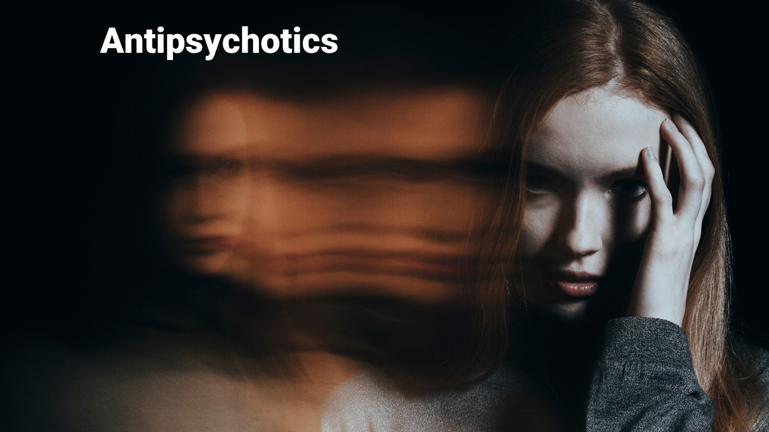
Antipsychotics
General information

Slide 64
Objectives for Part 4:
Antipsychotic agents
Briefly explain the hypothesised neurologic abnormalities that are found in individuals with schizophrenia and other forms of psychosis.
Explain the four major pathways for dopamine 2 in the brain and relate those to the actions of our antipsychotic medications
For each of the drugs noted below, be able to identify the drug class to which it belongs. (Simply identify it as a typical first class antipsychotic or atypical.)
  Typical antipsychotic agents include Haloperidol and Chlorpromazine, and
  Atypical antipsychotic agents include *Quetiapine*, *Aripiprazole*, *Risperidone*, and *Olanzapine*
For both of the drug classes above, briefly describe the mechanism by which drugs of that broad class exert their therapeutic effect, the general indications, contraindications and major side effects.

Slide 65
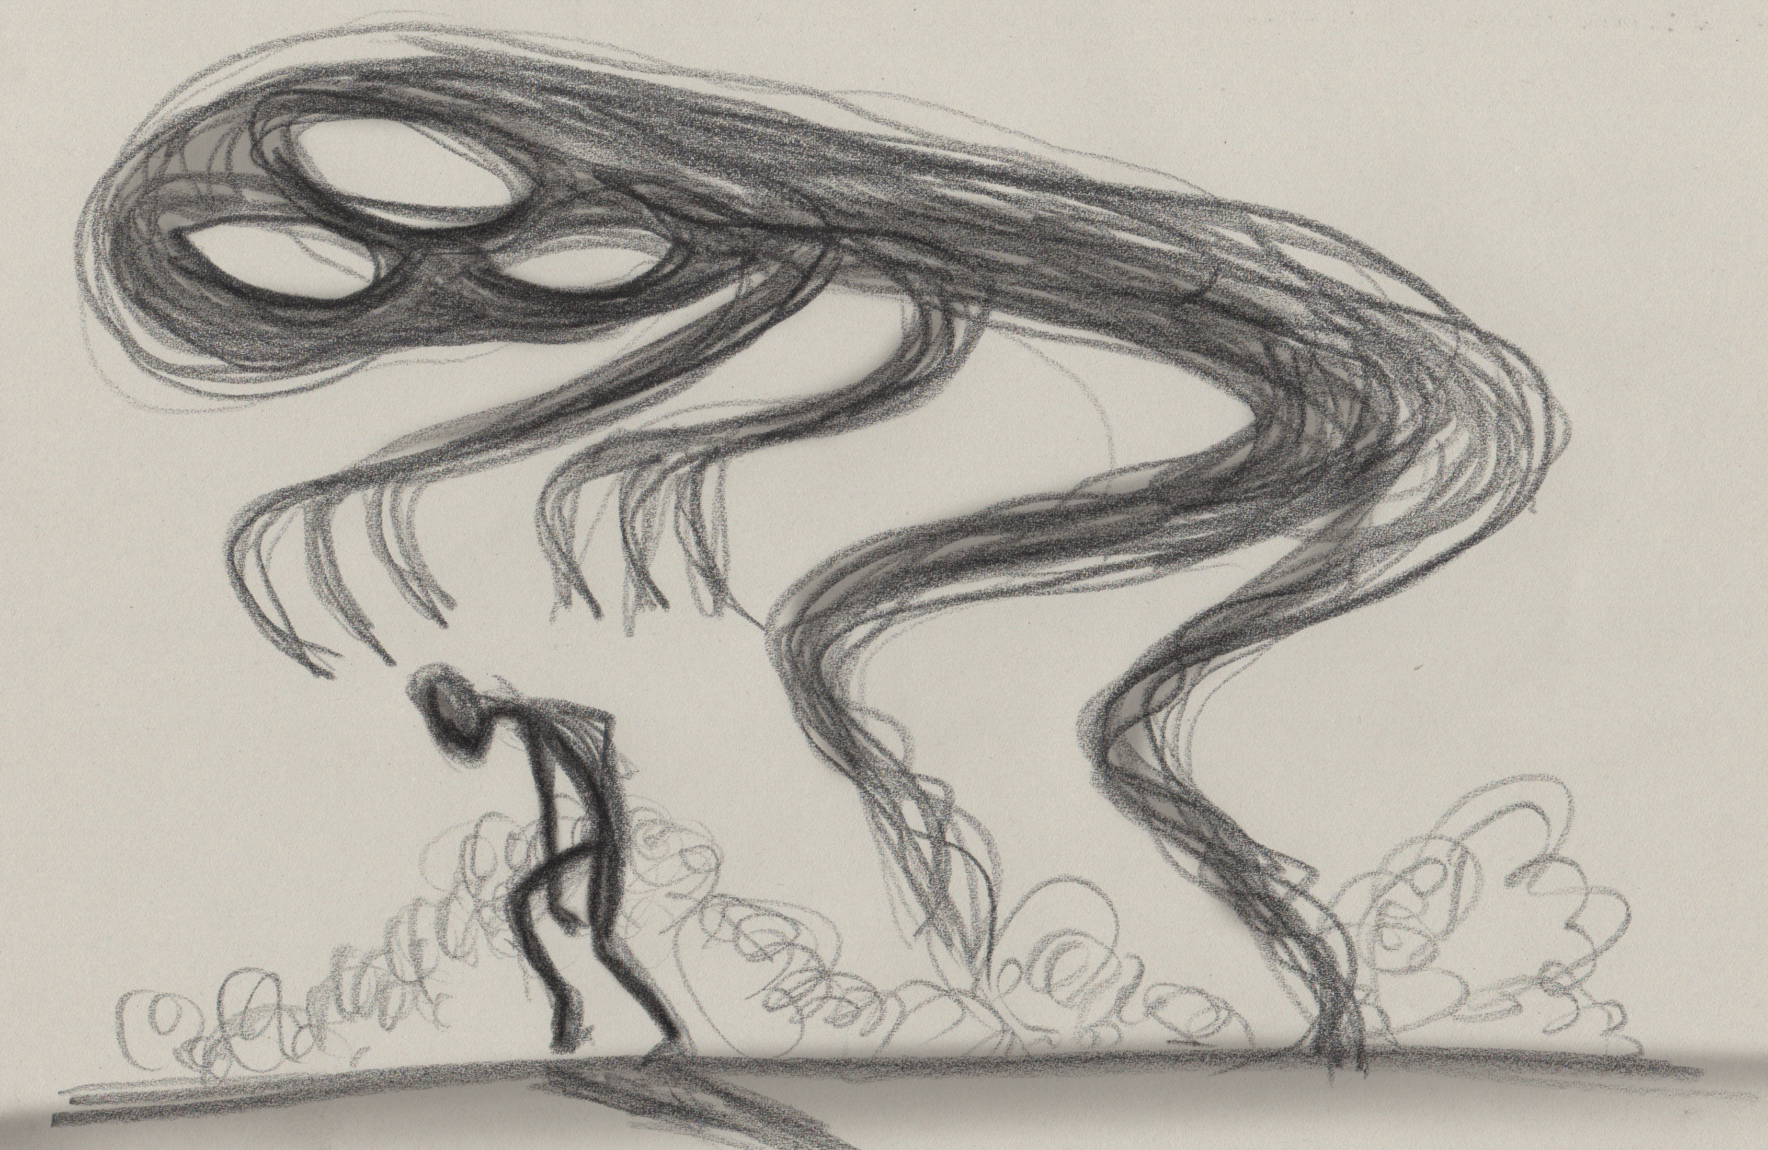
Antipsychotic agents
Psychoses: mental health disorders characterised by aberrant behaviour and disturbed emotional states.
  Schizophrenia, severe agitation and some forms of dementia
The most effective medicines in the treatment of the psychoses are the central dopamine receptor antagonists

Slide 66
Schizophrenia
Schizophrenia is relatively common, affecting 1 per cent of the population,
  Increased dopaminergic activity in certain parts of the brain, particularly the prefrontal cortex, limbic
  Onset 15 and 25
Symptoms of schizophrenia are described as either negative or positive.
Positive symptoms
  delusions, disorganised speech and/or thought, distorted perceptions and emotions, hallucinations and the belief that one is under the control of an external agency.
Negative symptoms
  toneless speech, vacant eyes, social withdrawal, anhedonia (lack of enjoyment) and apathy.

Slide 67
Dopamine pathways
Mesolimbic pathway – hyperactive in schizophrenia – yields positive symptoms like delusions
Mesocortical pathway - underactive in schizophrenia – contributes to negative symptoms
Nigrostriatal pathway – decreases in dopamine here result in Parkinsonian symptoms
Tuberoinfundibular pathway – controls prolactin release

Slide 68
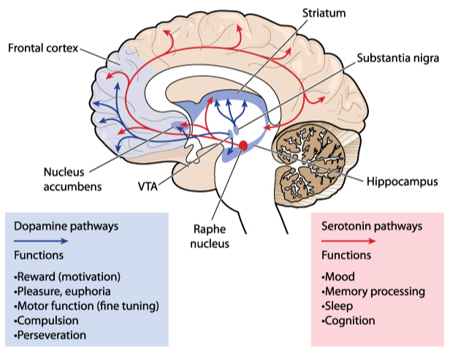
RED paths are serotonin
BLUE paths are DOPAMINE
Mesolimbic pathway – hyperactive in schizophrenia – yields positive symptoms like delusions

Slide 69
RED paths are serotonin
BLUE paths are DOPAMINE
Mesocortical pathway - underactive in schizophrenia – contributes to negative symptoms

Slide 70
RED paths are serotonin
BLUE paths are DOPAMINE
Nigrostriatal pathway – decreases in dopamine
here result in Parkinsonian symptoms

Slide 71
RED paths are serotonin
BLUE paths are DOPAMINE
Tuberoinfundibular pathway –
controls prolactin release

Slide 72
RED paths are serotonin
BLUE paths are DOPAMINE
Mesocortical pathway - underactive in schizophrenia – contributes to negative symptoms
Nigrostriatal pathway – decreases in dopamine here result in Parkinsonian symptoms
Tuberoinfundibular pathway – controls prolactin release

Slide 73
Antipsychotics
Specific medications

Slide 74
First generation antipsychotics
First generation antipsychotics
  Also termed ‘typical’ ‘neuroleptics’ or ‘major tranquillisers’
Haloperidol (Serenace) and Chlorpromazine (Largactil)
Similar mechanisms of action on the CNS
Main action is to antagonise dopamine receptors
  Numerous adverse effects

Slide 75
Adverse effects of Haloperidol, Chlorpromazine and other first generation antipsychotic agents
Worsening of the negative symptoms (lack of motivation, diminished energy, inability to express emotions, social withdrawal)
Parkinsonian symptoms
Excess prolactin (milk production, breast development in males and sexual dysfunction)
Long term effects include the opposite of parkinsonian symptoms, that being tardive dyskinesia (smacking of lips, etc)

Slide 76
Additional adverse effects of first generation antipsychotic agents
High potency agents
Example: Haloperidol
Cause more profound extrapyramidal symptoms and more galactorrhoea
Low potency agents
Example: chlorpromazine
Bind to alpha adrenergic receptors
  cause orthostatic hypotension
Bind to the acetylcholine receptor
  Cause eye pain
  Dry mouth
  Constipation
Bind to histamine 1 receptor
  Drowsiness,
  Sedation,
  Weight gain

Slide 77
Second generation antipsychotics
Second-generation (atypical) antipsychotics
*Quetiapine* (Seroquel), *Aripiprazole* (Abilify), *Risperidone* (Risperdal), and *Olanzapine* (Zyperxa)
The most important difference between the first and second generation antipsychotics is the tendency of the latter to induce fewer extrapyramidal disturbances.
Differences in their affinities for various central receptors may explain why the second generation antipsychotics are less prone to producing these adverse effects.

Slide 78
Second generation antipsychotic agents
*Quetiapine*
  Binds to Histamine 1 receptors and cause drowsiness
*Aripiprazole*
*Olanzapine*
  Binds to Serotonin 2c strongly and causes metabolic symptoms such as weight gain and high glucose
  Bind to Histamine 1 receptors and cause drowsiness
*Risperidone*
  Binds strongly to alpha 1 receptors (orthostatic hypotension)
  Highest amount of extrapyramidal symptoms and galactorrhoea

Slide 79
First generation vs second generation antipsychotics: review
Antipsychotic agents can be classified as either typical (first generation) or atypical agents (second generation).
Typical are much more active on the D2 receptors than are the atypical ones.
The atypical agents, have less affinity for the D2 receptors, usually have a lower incidence of debilitating motor disturbances
The goal is to find the right antipsychotic agent for the person: an agent that addresses the most disturbing symptoms without the side effects that may prompt the person to stop taking the medication.

Slide 80
Psychotropic medications: Part 5
Antiseizure medications
Dr Ken Wojcikowski

Slide 81
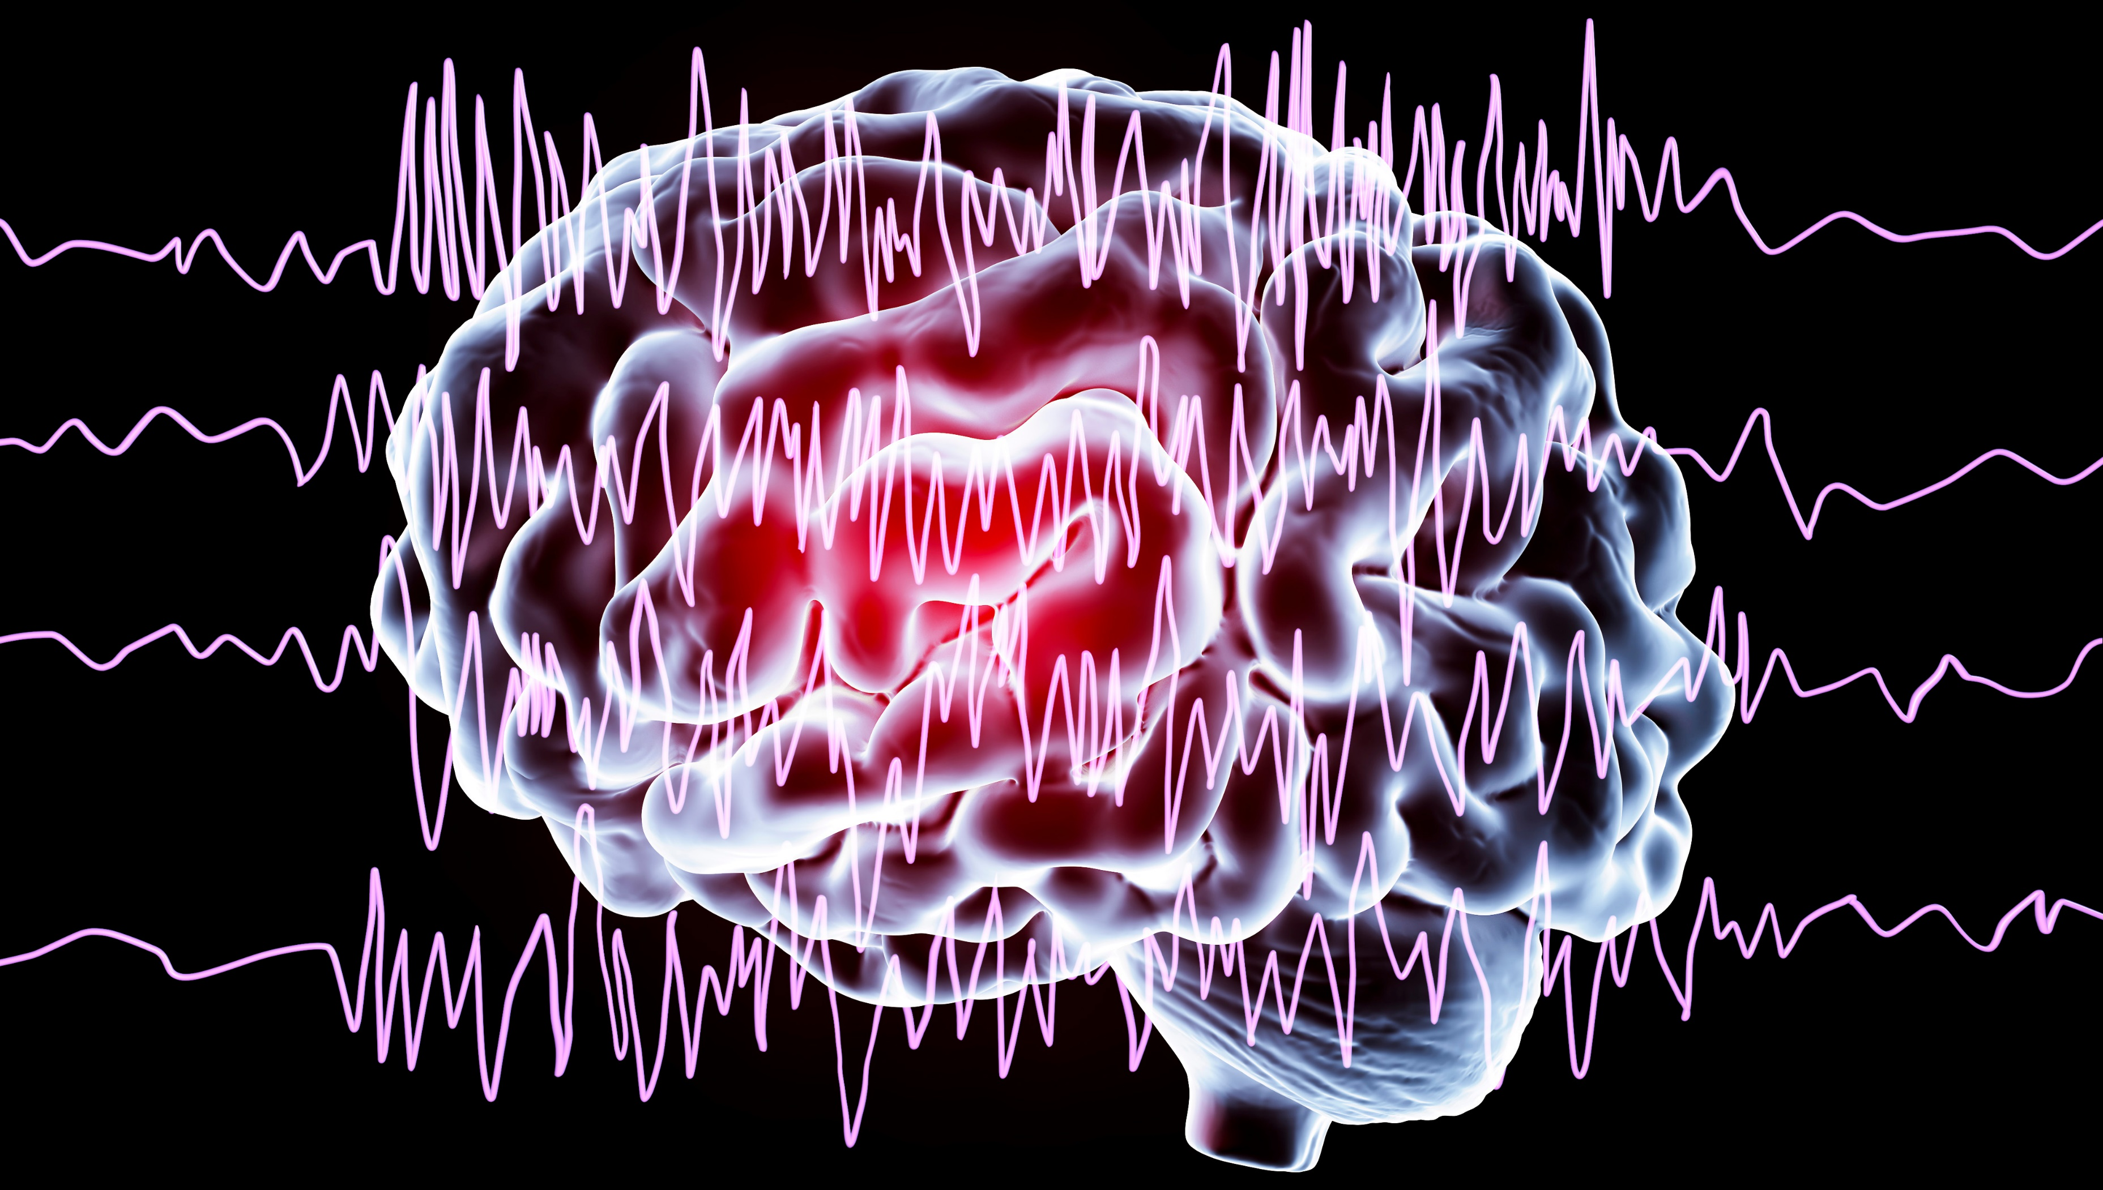
Antiseizure medications
Anti-seizure medications

Slide 82
Objectives for Part 5
Anti-seizure Medicines
Define the terms seizure, partial or focal seizure, generalized seizure, epilepsy, and status epilepticus.
For each of the following drugs, briefly explain the mechanism of action, and the major indications and side effects.
  Clonazepam and diazepam (the benzodiazepines)
  Gabapentin and Pregabalin,
  Carbamazepine and valproic acid (valproate)

Slide 83
Terms regarding seizures*
*
*The term anticonvulsant is misleading because some seizures do not manifest as convulsions.
Partial seizures – begin in one hemisphere at a single cortical focus
  Generalised seizures form across both hemispheres
    Consciousness is always lost
Epilepsy is a term used to indicate a condition of recurrent seizures
  It does not describe the nature of the seizure itself.
Status epilepticus: the affected person moves immediately from one seizure into another.
  Very dangerous unless treated immediately

Slide 84
How do you treat or prevent a seizure?
Increase chloride anions (the negative charge will decrease brain over activity)
Decrease sodium ions (the decrease in positive ions will decrease brain over activity)
Decrease calcium ions (the decrease in positive ions will decrease brain over activity)

Slide 85
Presynaptic neuron
Postsynaptic neuron
Glutamate release
GABA release
Neurons in the brain
Inhibitory interneurons

Slide 86
General mechanisms
Antiseizure medications
Inhibitory interneurons release GABA
Gaba binds to GABA receptor
Chloride anion travels into the cell
More inhibition
If a drug acts like GABA or potentiates the action of GABA, it can decrease brain over activity

Slide 87
Benzodiazepines
Antiseizure medications
Intravenous diazepam or lorazepam are first-line treatments for status epilepticus
Should not be used to prevent seizures because tolerance develops
(refer to anxiolytics for further information)
Benzodiazepines potentiate the actions of the inhibitory neurotransmitter GABA

Slide 88
Gabapentin and Pregabalin
Antiseizure medications
X
LESS Glutamate released
Decrease activity of calcium channels
Treat partial seizures and neuropathic pain
Gabapentin is the first-line medication for the treatment of neuropathic pain
Side effects: sleepiness and dizziness are the most common.
Calcium
Gabapentin and pregabalin inhibit the calcium into the presynaptic neurons which results in less excitation throughout the brain

Slide 89
Carbamazepine and valproic acid
Antiseizure medications
X
LESS Glutamate released
Decrease sodium into the presynaptic neuron
Sodium
Carbamazepine and valproic acid decrease the sodium into the presynaptic neurons.
This decreases the amount of glutamate released = decreased excitation

Slide 90
  Carbamazepine
  Carbamazepine (CBZ) is an anti seizure and mood-stabilizing drug used primarily in the treatment of epilepsy and neuropathic pain.
  Generalized seizures
  CBZ is a sodium channel blocker .
  Adverse effects may include nausea and drowsiness
  Bone marrow dysfunction is possible
  Check LFTs and FBCs periodically!

Slide 91
  Valproic acid
  Valproic acid is an anti seizure and mood-stabilizing drug used primarily in the treatment of epilepsy and bipolar disorder.
  Partial and generalized seizures
  Valproic acid is a sodium channel blocker (and may increase GABA).
  Side effects include nausea, sleepiness, dry mouth

Slide 92
Antiseizure medications
Anti-seizure medications

